Slide 1
Job data analysis
By: Anvi Agarwal

Slide 2
Project Overview: Operational Analytics for Job and User Data Analysis
This project involves two case studies designed to simulate the role of a Lead Data Analyst focusing on operational analytics. The aim is to uncover valuable insights that help a company improve its operations by analyzing data for trends, anomalies, and metric spikes using SQL.

Slide 3
Case Study 1: Job Data Analysis
Purpose:
To analyze the performance and behavior of job reviews over time using the job_data table. This table includes detailed information such as job IDs, reviewer (actor) IDs, event types, time spent, and job language.
Planned Approach:
Jobs Reviewed Over Time:
Use SQL queries to calculate the number of jobs reviewed per hour for each day in November 2020, enabling us to identify peak and low-activity hours.
Throughput Analysis:
Calculate a 7-day rolling average of events per second, and compare it with daily metrics to determine which method better reflects job handling efficiency.
Language Share Analysis:
Determine the language distribution of job content over the last 30 days to see trends or shifts in content language preferences.
Duplicate Rows Detection:
Identify and display duplicate entries in the job_data table that might affect data integrity and result accuracy.

Slide 4
Case Study 2: Investigating Metric Spikes
Purpose:
To explore the causes behind sudden changes in key business metrics using three tables: users, events, and email-events. This case simulates a real-world challenge of understanding metric spikes through user activity.
Planned Approach:
Weekly User Engagement:
Measure how actively users engage with the product weekly using the events table.
User Growth Analysis:
Analyze the trend of new users signing up over time using the users table.
Weekly Retention Analysis:
Measure how many users remain active after signing up, by calculating weekly retention rates based on sign-up cohorts.
Engagement Per Device:
Assess user activity across different devices to understand usage patterns and optimize cross-platform experiences.
Email Engagement:
Use the email_events table to analyze open rates, click-throughs, and overall engagement with email communications.

Slide 5
Software used
MySQL Workbench (Version 8.0)
MySQL Workbench was used for executing SQL queries, managing the database, and analyzing user activity data. I chose this tool because it provides a user-friendly interface for writing and testing queries, supports complex data manipulation, and is well-suited for handling structured data efficiently.
Microsoft Excel (2019)
I used Excel for initial data cleaning, organizing, and performing basic exploratory analysis. Its simplicity, flexibility, and visualization features made it ideal for quick summaries, creating charts, and preparing the data before deeper analysis.
Tableau Public desktop
I used tableau public for better data visualization and better data analysis

Slide 6
Case study 1

Slide 7
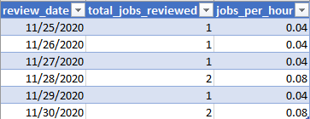
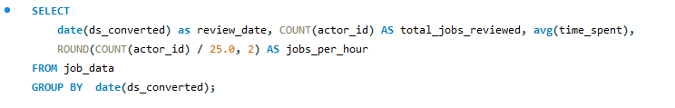
Number of jobs reviewed per hour for each day in November 2020
Job review activity was consistently low from Nov 25–30, 2020, with only 1–2 jobs reviewed per day, averaging 0.04–0.08 jobs/hour. Slight increases on Nov 28 and 30 may suggest end-of-month catch-up. Overall, the workload appears minimal and stable, indicating a need to assess job volume or analyst efficiency.

Slide 8
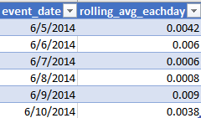
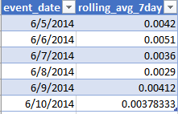
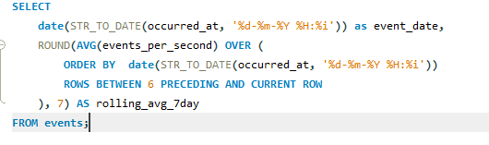
7 day and 1 day rolling average (no. of events per sec)
Use 7-day rolling average for strategic decisions and monitoring trends. Use daily values only when short-term or real-time issues need investigation.
7 day rolling average smmothes the sudden spikes and gice consistent trend

Slide 9
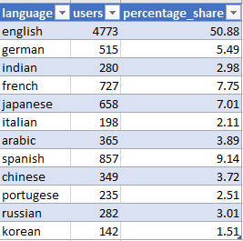
% share of each language in last 30 days
English dominates with 50.88% share, indicating it's the primary language used.
Other top languages include Spanish (9.14%), French (7.75%), and Japanese (7.01%), showing notable global engagement.
Languages like Korean (1.51%), Italian (2.11%), and Indian (2.98%) have relatively low representation.
📌 Insight: While English leads, there is a diverse multilingual user base—consider investing in localization and support for high-growth non-English languages like Spanish and French to expand global reach.

Slide 10
Duplicate rows in job_data table
It gives no output means no duplicate rows

Slide 11
Case study 2

Slide 12
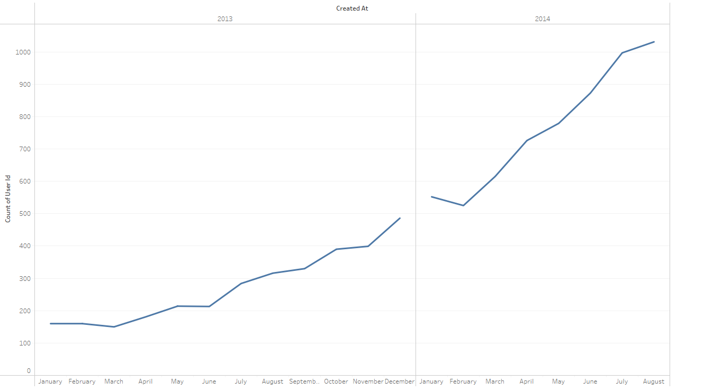
User Growth Analysis
In 2013, user growth was steady but slow, with minor increases from May to December.
Significant growth began in March 2014, accelerating through May, June, and July, peaking in August.
User count rose from around 500 in January 2014 to over 1000 by August 2014, nearly doubling in just 8 months.
Insight: The strong upward trend from March to August 2014 suggests impactful product changes or successful user registrations during that time. Focus analysis on these months to uncover key growth drivers.

Slide 13
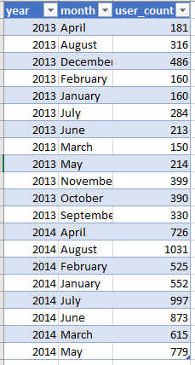
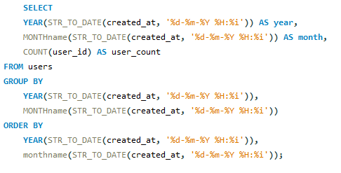

Slide 14
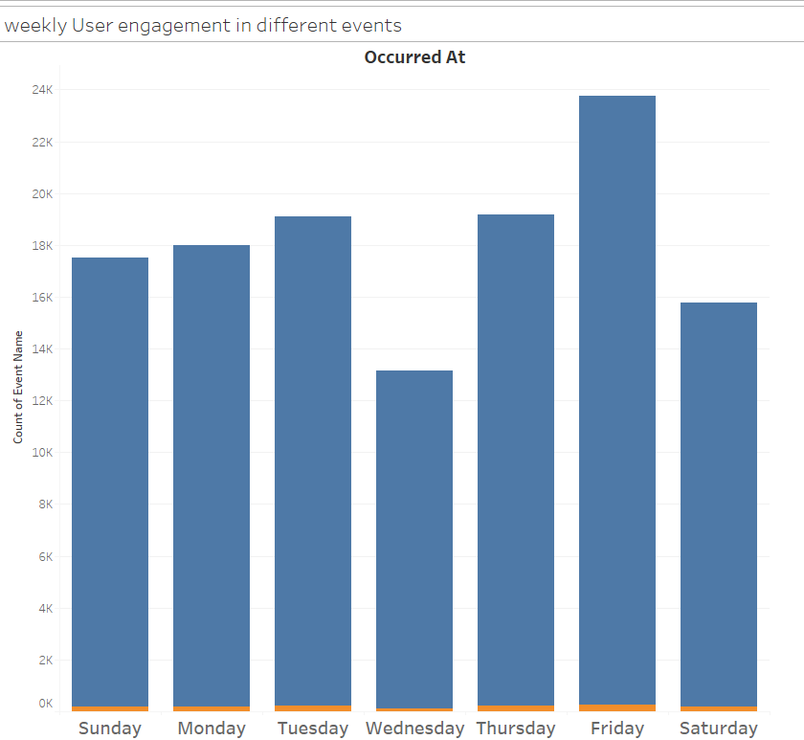

Weekly user engagement in different events
Maximum users are engaged in some events during Fridays shows more user enagement on this day so more events can be conducted on this weekday to increase the user engagement more and resources can be optimized accordingly

Slide 15
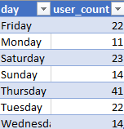
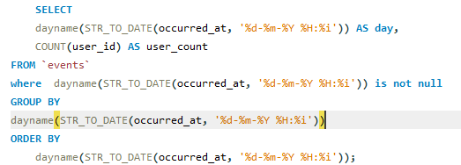

Slide 16
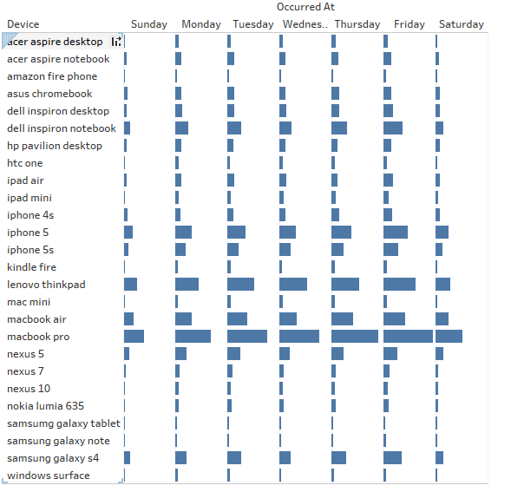
Activeness of users on weekly basis per device
MacBook Pro users show the highest and most consistent activity throughout the entire week, indicating heavy and regular usage.
Devices like iPhone 5, iPad Mini, and Lenovo ThinkPad also display high activity, especially during weekdays.
Weekend activity is generally lower across most devices, suggesting usage is driven more by work or school-related tasks.
Devices such as Asus Chromebook, Kindle Fire, and HTC One show minimal usage, implying low popularity or sporadic engagement.
Activity peaks midweek (Tuesday to Thursday) across many devices.
This pattern indicates that device usage is strongly tied to weekday productivity and diminishes during weekends for most users.

Slide 17
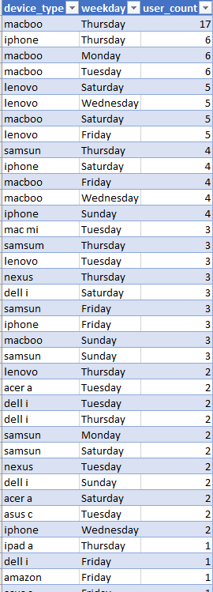
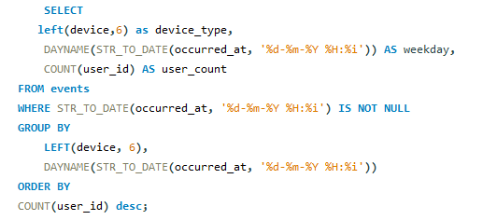

Slide 18
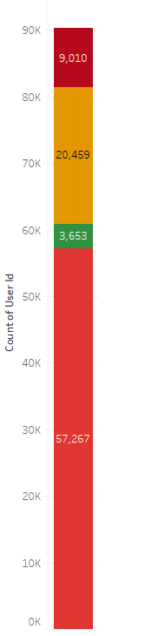
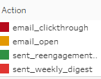

Email engagement analysis
Most users (57,267) received the weekly digest email, but only 20,459 opened them, and just 9,010 clicked through, indicating a low engagement rate.
A small portion (3,653) were sent re-engagement emails, suggesting a segment of inactive users being targeted.
The clickthrough rate is notably low compared to the number of emails sent and opened, pointing to potential issues with content relevance or call-to-action effectiveness.
Improving subject lines, content value, and CTAs could help boost engagement.

Slide 19
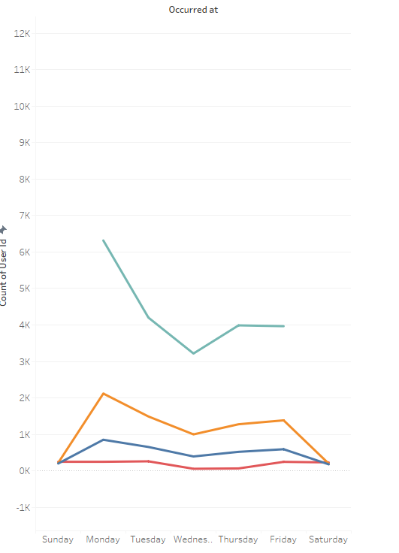
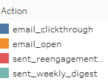
Email engagement peaks on Monday, with the highest opens and clickthroughs. Activity declines midweek and drops sharply on weekends. Weekly digests are mostly sent early in the week. Reengagement remains consistently low.
Recommendation: Send key emails early in the week to boost engagement.

Slide 20
